Slide 1

Predicting Customer Buying Behaviour
Meher Vamsi Akshay. V
20/02/2025

Slide 2
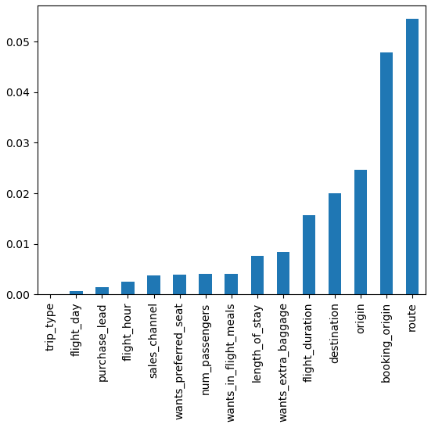
EDA- Feature Selection
Features selected by 3 methods:
Pearson correlation
Mutual_info_classif
Features extracted from hyperparameter tuning of RF model
Both gave different features dependency on the target variable(Booking Complete).
Mutual info classif gave high dependency to route, booking origin, length of stay and low dependency to flight hour and sales channel.
Feature Selection by Mutual_info_classif

Slide 3
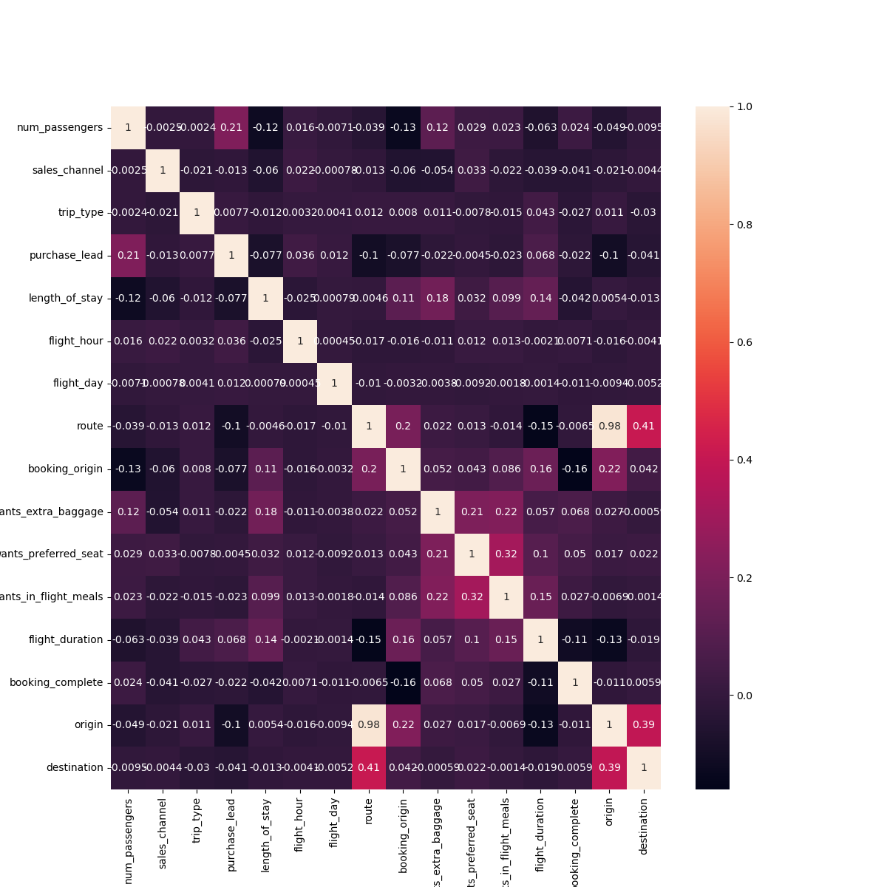
Pearson correlation provide high dependency to extra meal, extra baggage and in-flights meals along with number of passenger travelling with Booking complete and gave low dependency to features like flight duration and booking origin.
The heatmap shows the correlation of variables with themselves and with other variables.
Heatmap by Pearson Correlation

Slide 4
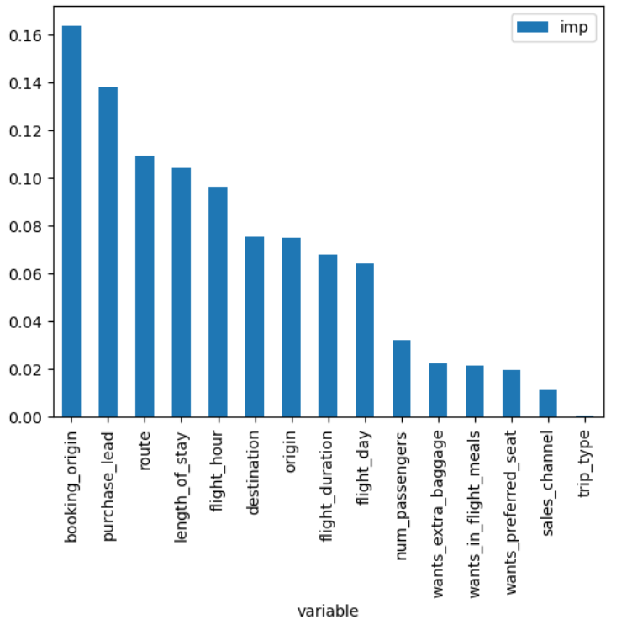
After analyzing different feature selection technique, Hyperparameters tuning of the model helps to provide importance to features.
Hyperparameter values are
N_Estimator = 500
Max_depth = 20
min_sample_leaf = 5
Which gave an overall accuracy of 85.38%.
Here, Booking origin , purchase lead , route, length of stay and flight hour are 5 top contributors for the customers to book their holiday.
Feature Selection by Hyperparameter tuning of RF model

Slide 5
Result
With an overall accuracy of 85.38%, Random Forest model is predicting whether a customer will book the holiday or not based on the top 5 parameters, which are
Booking origin
purchase lead
Route
length of stay
flight hour
So, we should focus on countries where most of the holiday bookings are done and the destination of the holiday. Along with that, we can work on reducing the connecting flight as it will reduce the flight hour which can increase the customer booking tickets.

